Slide 1

1st Quarter Beadies
2022-2023

Slide 2
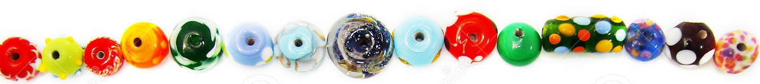
First quarter, students earned beadies for…
HIGHEST AVERAGE
MOST IMPROVED
TEACHER AWARD
ATHLETICS
HONOR ROLL (A & A/B)

Slide 3



WITHIN CATEGORICAL GOATS
TEACHER AWARD
HIGHEST AVERAGE
HONOR ROLL
MOST IMPROVED

Slide 4
MULTI CATEGORICAL GOATS
TEACHER AWARD
HIGEST AVERAGE
HONOR ROLL
MOST IMPROVED
SPORTS

Slide 5


Slide 6
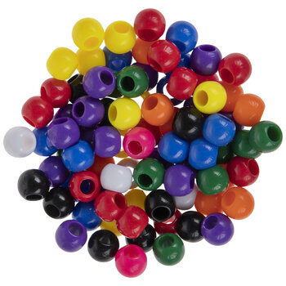
HIGHEST AVERAGE – ONE BEADIE

Slide 7

HIGHEST AVERAGE – TWO BEADIES

Slide 9
Jovan Jones
Thomas Summers

Slide 10

Remain standing until everyone’s name has appeared on the screen.

Slide 11
TEACHER AWARD – ONE BEADIE (A-Mc)

Slide 12
TEACHER AWARD – ONE BEADIE (Mc-W)

Slide 13
TEACHER AWARD – TWO BEADIES

Slide 14
Finn Allen-Coqk Walker
Oliver Brown
Mariyah Crawford

Slide 15


Slide 16
MOST IMPROVED – ONE BEADIE

Slide 17
MOST IMPROVED – TWO BEADIES

Slide 18
Reagan Anthony

Slide 19





ATHLETICS
Beadie

Slide 20
ATHLETICS (Volleyball, Football, Softball, & Golf)

Slide 21


A/B HONOR ROLL Beadie
Remain standing until everyone’s name has appeared on the screen.

Slide 22
A/B HONOR ROLL (A-F)

Slide 23
A/B HONOR ROLL (G-Me)

Slide 24
A/B HONOR ROLL (Me-Y)

Slide 25

“A” HONOR ROLL Beadie
Remain standing until everyone’s name has appeared on the screen.

Slide 26
“A” HONOR ROLL (A-Mc)

Slide 27
“A” HONOR ROLL (Mc-Y)

Slide 28
A/B + A
93
+
84
177/350
50.6%!!!
Piedmont You Know!!!

Slide 29
MULTI-CATEGORICAL GOATS
TEACHER AWARD
HIGEST AVERAGE
HONOR ROLL
MOST IMPROVED
SPORTS
NJHS Inductees

Slide 30
Beadie Multi-Categorical
G.O.A.T.s
Remain standing until everyone’s name has appeared on the screen.

Slide 31
Beadie Goats
Last names A-K

Slide 32
Beadie Goats
Last names L-W

Slide 33
Beadie Multi-Categorical
G.O.A.T.s

Slide 34
Beadie Goats

Slide 35
MULTI-CATEGORICAL GOATS
TEACHER AWARD
HIGEST AVERAGE
HONOR ROLL
MOST IMPROVED
SPORTS

Slide 36

HIGHEST AVERAGE, MOST IMPROVED, TEACHER AWARD, ATHLETICS, & HONOR ROLL
MOST DECORATED STUDENTS
Lela Coble
Jolen Davis
Tucker Schaperjohn
Brent Williams
Tayari Williams

Slide 37
If your name was left off, please send me an email stating which beadie you did not receive.
Jamese.oneal@cms.k12.nc.us

Slide 38
See you next time for another Beadie Awards.

